Slide 1
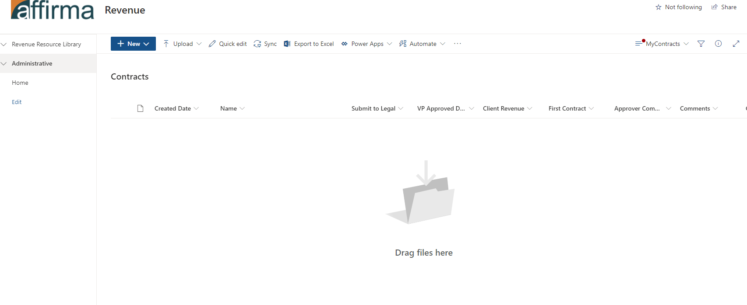
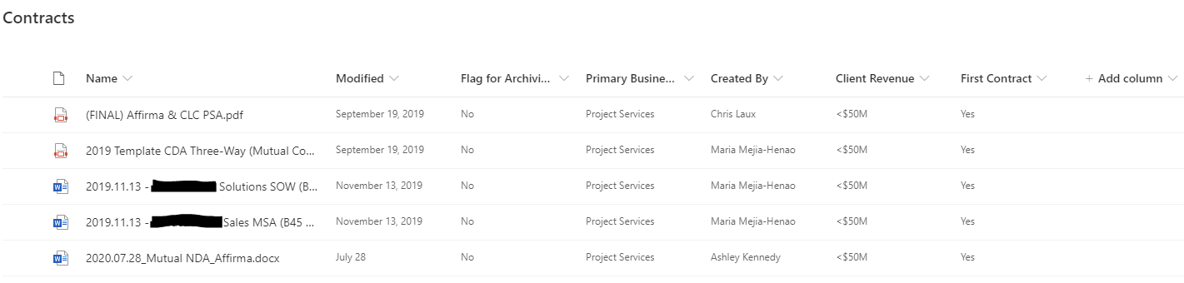
Affirma – Contract Management Process
Business Need
Affirma needed to provide our Account Management teams with a reliable centralized platform to manage a variety of legal documentation.
Our Revenue teams are tasked with the creation of contracts, MSAs, SOWs, Partner Agreements, and other kinds of templatized contracts.
We created a file repository with extensive metadata to categorize and store documentation, as well as an automated approval flow that notifies our legal team and exec-level sponsers when a new contract is submitted.
The SharePoint Library also has several custom views and direct access to new document templates, allowing users to quickly create and find the content they need.

Slide 2
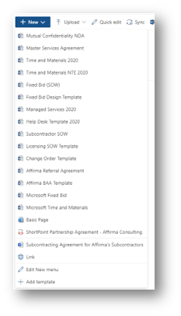
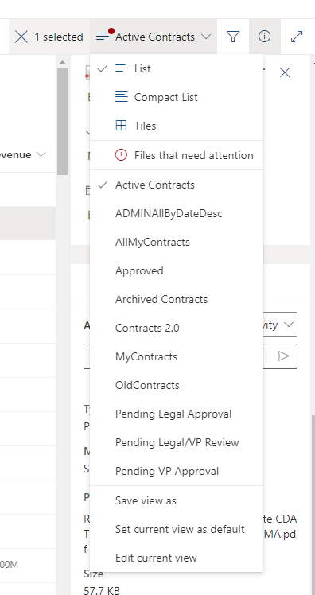
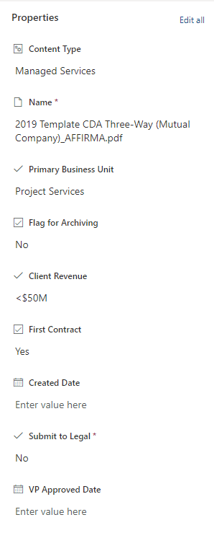
Affirma – Contract Management Process
Screenshots

